Slide 1


ORACLE
NETSUITE ERP
Presented by Group 7:
Pooja Manjarekar
Akshata Ghumatkar
Shubham Bhatnagar
Devraj Raghuwanshi
Amit Kumar

Slide 2
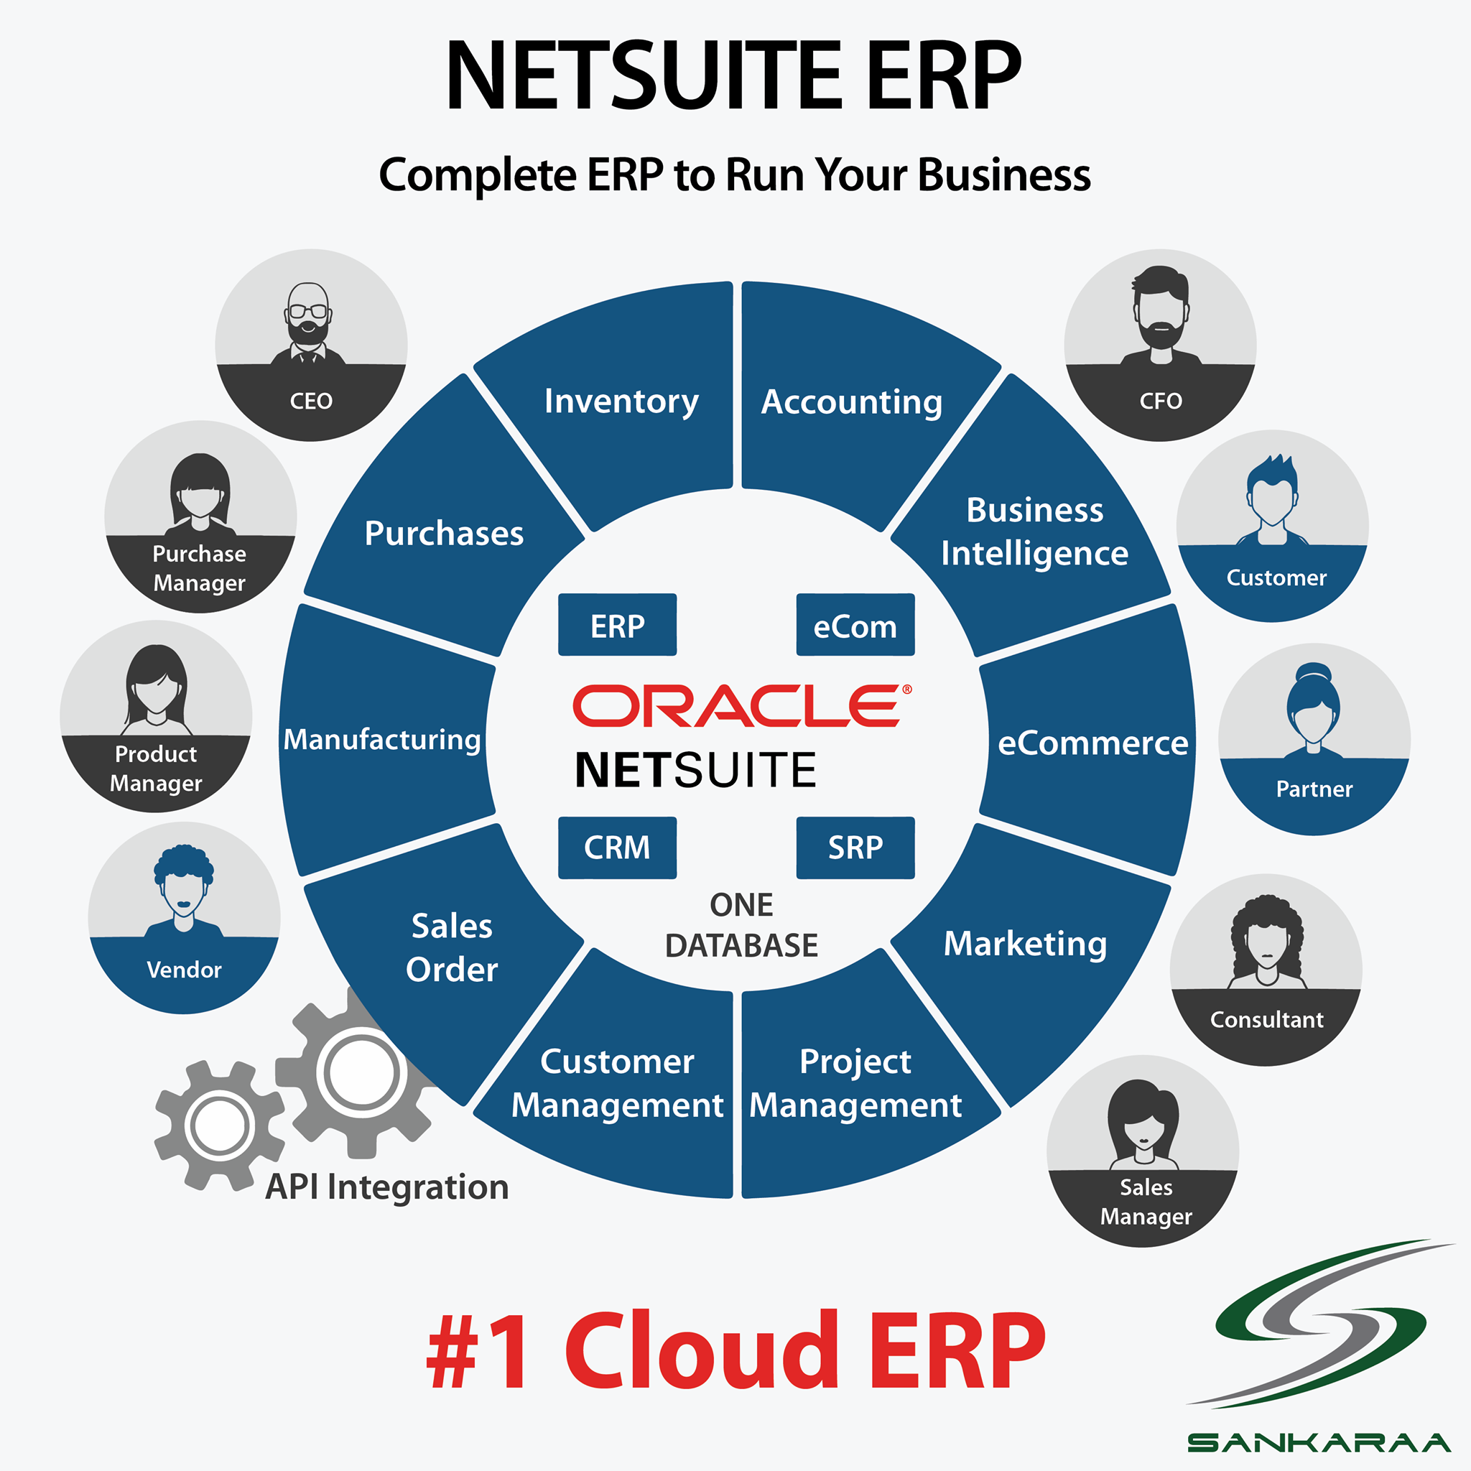
NetSuite: A Cloud Based ERP
Comprehensive business management suite
Enables businesses to streamline their operations
HISTORY
Cloud ERP - first offered by NetSuite
Founded in 1998 as NetLedger by Evan Goldberg
Serving over 42,000 customers worldwide

Slide 3
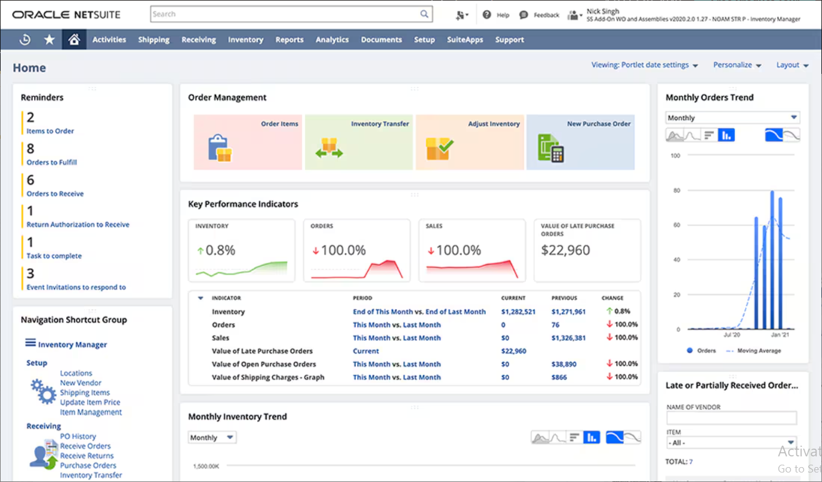
What is NetSuite Order Management?
A cloud-based solution for managing the entire order-to-cash process.
Centralizes order processing across multiple sales channels.
Ensures accuracy, speed, and customer satisfaction.

Slide 4





Key Features of NetSuite Order Management
Omnichannel support (e-commerce, in-store, marketplaces).
Seamless integration with inventory, shipping, and billing.
Real-time order tracking and visibility..
Automated order orchestration and workflows.
Automated order orchestration and workflows.

Slide 5
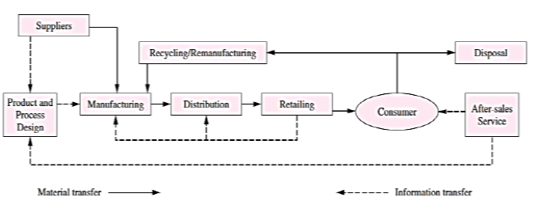
NetSuite in Manufacturing

Slide 6

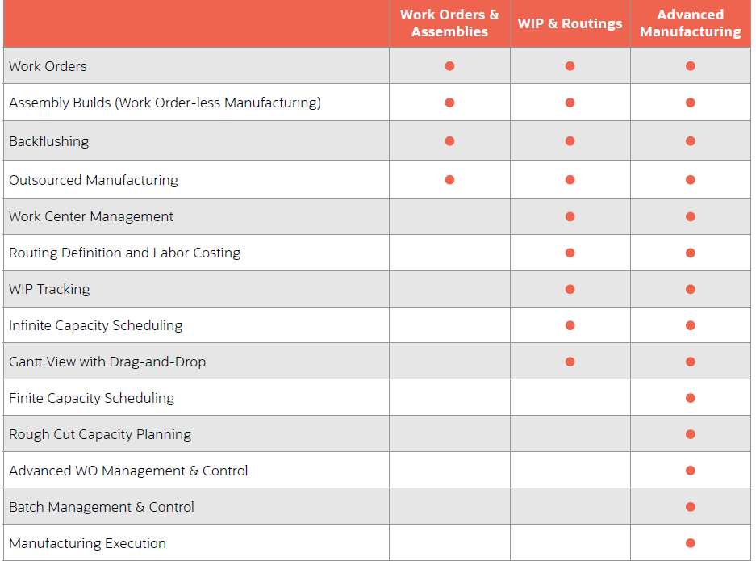
Deployment Options

Slide 7

NetSuite Advanced Manufacturing
It integrates manufacturing operations with financial reporting and inventory management providing a Real-time Integration.
The platform supports mobile capabilities, including integrated barcode scanning and tablet functionality
Manufacturers can effectively manage shop floor activities.
NetSuite provides an enhanced Manufacturing Work Bench with detailed operations routings, finite planning parameters, and labor requirements.
NetSuite offers recipe and formulation management, FIFO material issuance, and batch tracking.

Slide 8



Pro-FLEX MANUFACTURING CASE STUDY
Company Overview
Need for a New ERP
Transforming Operations with NetSuite ERP

Slide 9



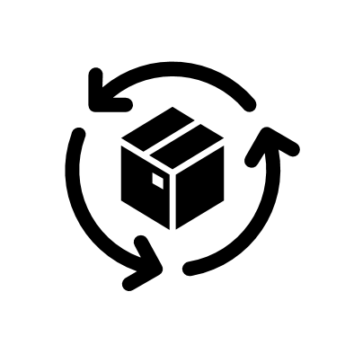

Lack of Data Visibility
Incomplete & Outdated Data
Manual Processes
Ineffective Tracking
Key Business Hurdles for Pro-Flex

Slide 10
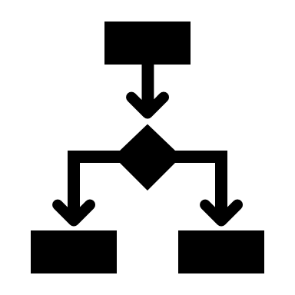




Benefits of NETSUITE IMPLEMENTATION
Improved Operational Efficiency
Better Supply Chain & Inventory Management
Real-Time Financial & Business Insights
Scalability & Cloud Accessibility
Regulatory Compliance & Quality Control

Slide 11

Future scope
AI & Machine Learning for Predictive Analytics
Advanced Automation & Smart Factories
Cybersecurity & Data Protection in ERP Systems

Slide 12
Thank You!

